Slide 1


🚀 AI Governance Audit Tool – User Guide & Benefits
Ensuring Data Compliance, Security, and Quality with AI.
Presented by [Your Name].
by Mihir kumar Mallick

Slide 2
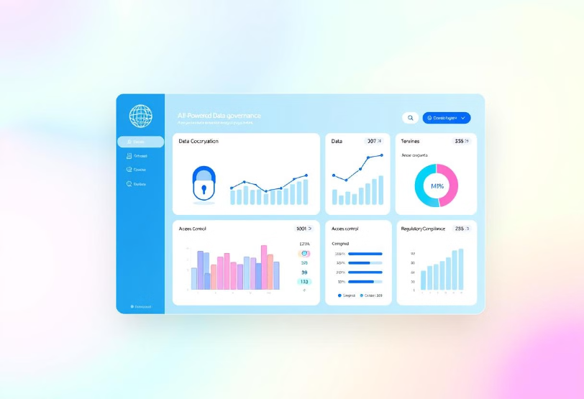
What is this Tool?
Comprehensive AI-powered governance tool.
Data quality, security, compliance.
Lineage tracking.
ETL scripts, SQL queries, reports, metadata.
Generates structured JSON/CSV reports.
🎯 Goal: Enhance data integrity, security & compliance, reduce manual effort.

Slide 3





Key Features
AI-Powered Audits
Detect security risks, compliance gaps.
Multi-Data Support
ETL, databases, logs, reports.
Data Quality Checks
Duplicates, schema mismatches.
Security & Compliance
GDPR, HIPAA, ISO, SOX.

Slide 4





How It Works (Step-by-Step)
Upload Data
ETL scripts, SQL queries, metadata.
AI Extracts Metadata
Detects schemas, dependencies, usage.
Audit Engine Analyzes
Detects security & compliance risks.
AI Provides Fixes
Recommends improvements.

Slide 5
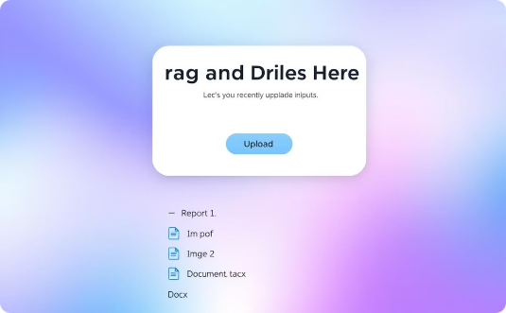
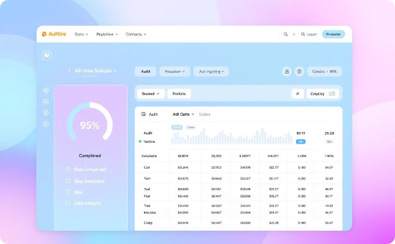
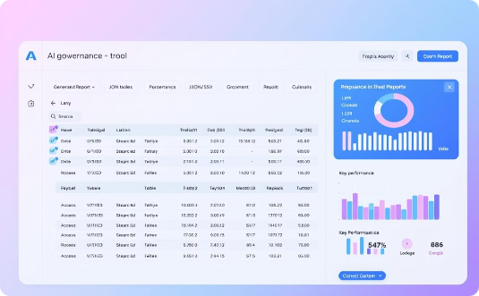
Application Screenshots
File Upload
Audit Dashboard
Report Output

Slide 6




Benefits & Why Use It?
Automates Governance
Ensures Compliance
Improves Quality
Saves manual effort.
Supports GDPR, HIPAA, ISO.
Detects errors, duplicates.
Enhances Security - Flags vulnerabilities. Tracks Data Lineage - Transparency. Structured AI Reporting - JSON/CSV reports.

Slide 7

Data Lineage Tracking
Source-to-destination flow mapping.
Transparency & accountability.
Track data transformation.
Dependencies, usage visualization.

Slide 8

Conclusion
AI Governance Audit Tool: Ensuring data compliance, security, and quality.

